Slide 1
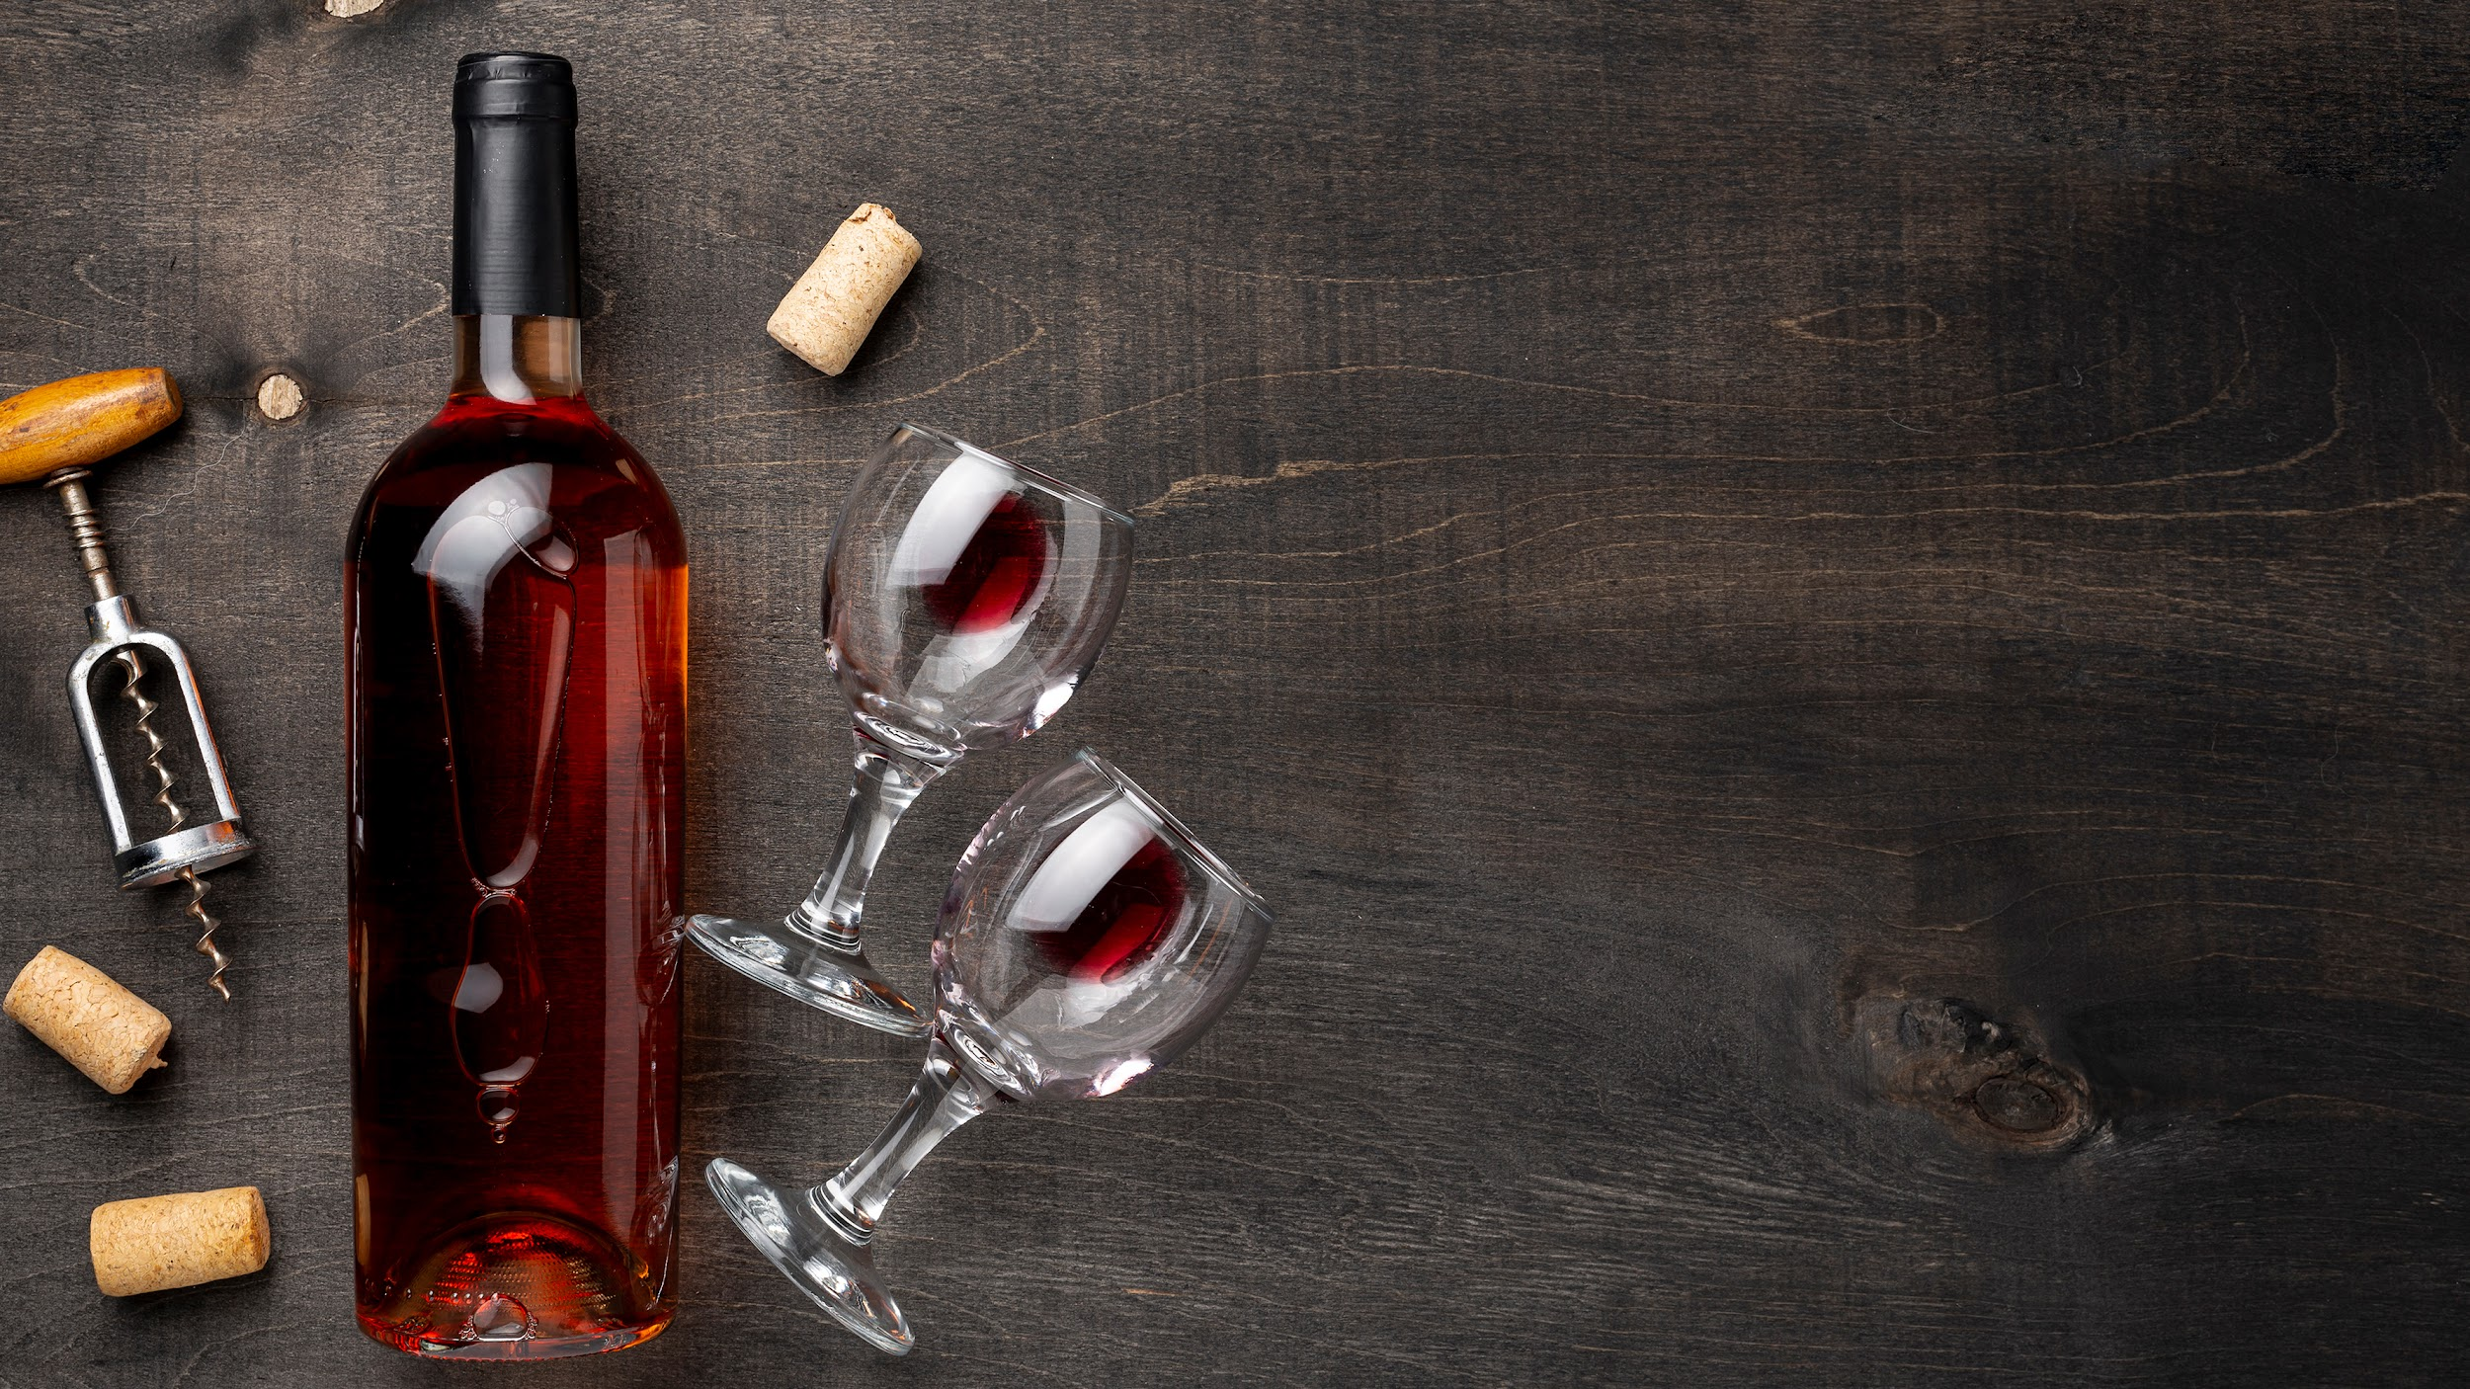
Unlocking the Secrets of High-Quality Wine Using Machine Learning CMSE 802
ADITYA DHAKA

Slide 2
Overview:
Key Aspects of the Project:
The project involves classifying red wines into "good" and "bad" categories based on their chemical properties. This classification is critical for both producers and consumers to assess wine quality without relying solely on subjective tasting. A variety of machine learning models were tested to identify the most effective method for predicting wine quality.
Data Source: The dataset used is from the UCI Machine Learning Repository, containing red wine chemical properties such as alcohol content, acidity, sugar levels, and more.
Task: The goal is to classify wines as either good (quality > 7) or bad (quality ≤ 7) based on these features.

Slide 3
methodology
Test and compare various classification models using Accuracy, Precision, Recall, F1-Score, Confusion Matrix
Provide actionable insights to help consumers and producers.
Model Application
Insights
Data Preparation
Feature Analysis
Clean and organize the data
Various plots were generated (box plots, heatmaps, violin plots) to understand the distribution of features and their relationship to quality.

Slide 4
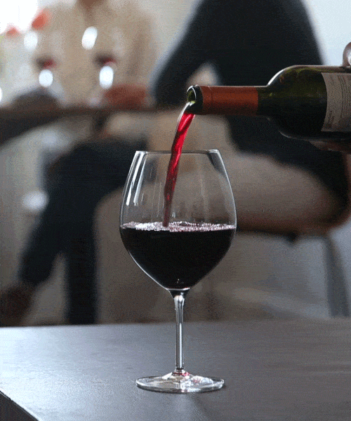



wHAT SETS US APART?
Tools
Models
Visual Studio Code
Jupyter Notebook
GitHub
Random Forest
Logistic Regression
Decision Tree
Gaussian Naive Bayes
K-Nearest Neighbors (k-NN)
Multi-Layer Perceptron (ANN)
XGBoost
Support Vector Machine (SVM)
Gaussian Naive Bayes

Slide 5
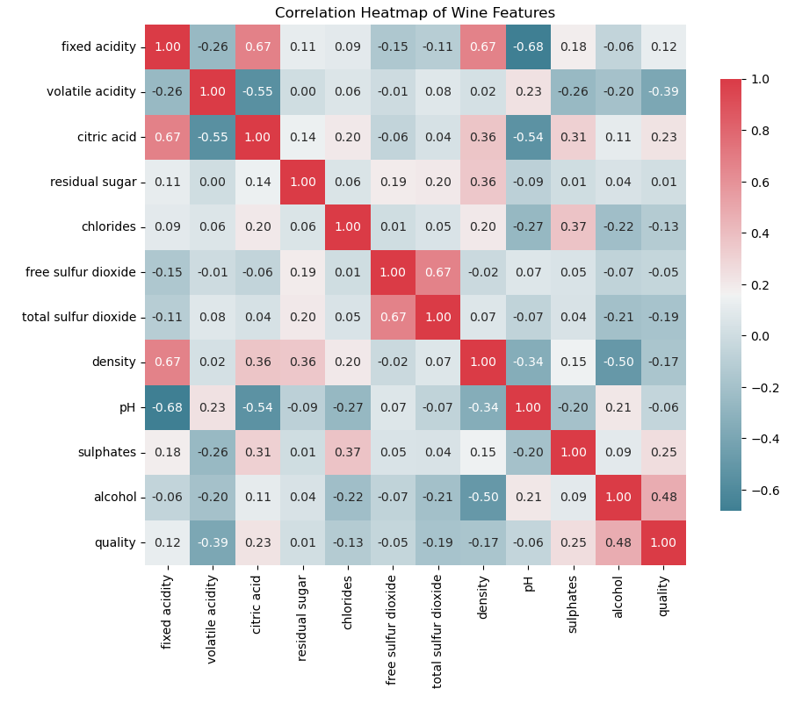
correlation
The correlation of each feature with quality, sorted in descending order:
quality 1.000000
alcohol 0.476166
sulphates 0.251397
citric acid 0.226373
fixed acidity 0.124052
residual sugar 0.013732
free sulfur dioxide -0.050656
pH -0.057731
chlorides -0.128907
density -0.174919
total sulfur dioxide -0.185100
volatile acidity -0.390558

Slide 6
Results
Model | Accuracy | Precision (Class 0) | Recall (Class 0) | F1-Score (Class 0) | Precision (Class 1) | Recall (Class 1) | F1-Score (Class 1) | Macro Avg (Precision) | Macro Avg (Recall) | Macro Avg (F1-Score)
Logistic Regression | 87.92% | 0.90 | 0.97 | 0.93 | 0.59 | 0.27 | 0.37 | 0.74 | 0.62 | 0.65
Decision Tree | 87.50% | 0.94 | 0.92 | 0.93 | 0.52 | 0.59 | 0.55 | 0.73 | 0.75 | 0.74
Random Forest | 90.83% | 0.93 | 0.97 | 0.95 | 0.71 | 0.51 | 0.59 | 0.82 | 0.74 | 0.77
K-Nearest Neighbors | 85.63% | 0.90 | 0.94 | 0.92 | 0.42 | 0.27 | 0.33 | 0.66 | 0.61 | 0.62
Support Vector Machine | 88.43% | 0.91 | 0.97 | 0.94 | 0.59 | 0.32 | 0.41 | 0.75 | 0.64 | 0.67
Gaussian Naive Bayes | 83.96% | 0.91 | 0.91 | 0.91 | 0.39 | 0.40 | 0.39 | 0.65 | 0.65 | 0.65
Multi-Layer Perceptron | 86.25% | 0.89 | 0.96 | 0.92 | 0.45 | 0.22 | 0.30 | 0.67 | 0.59 | 0.61
XGBoost | 88.12% | 0.92 | 0.94 | 0.93 | 0.56 | 0.46 | 0.50 | 0.74 | 0.70 | 0.72

Slide 7
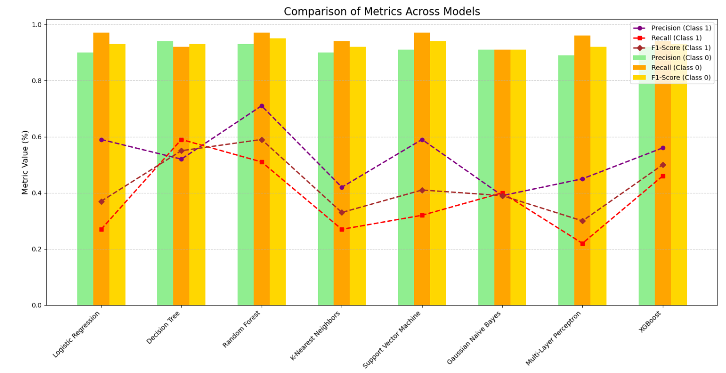
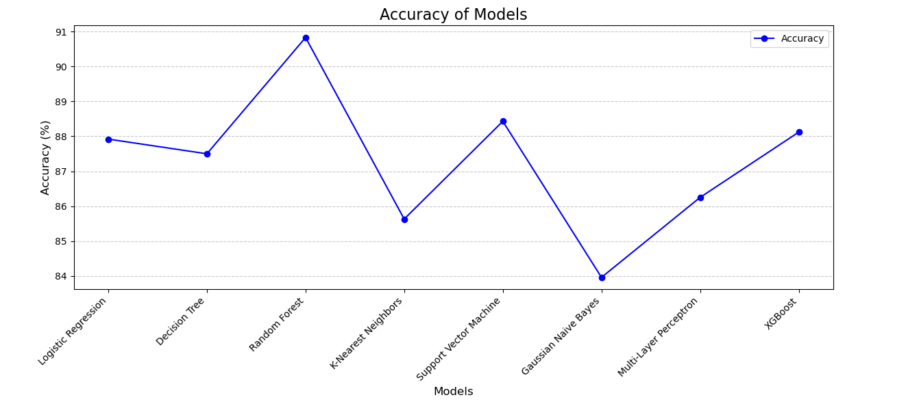
Key Insights:
Random Forest performed the best with the highest accuracy and a good balance between precision and recall.
XGBoost offers better balance for both classes, making it the best choice for datasets where minority class performance is crucial.
Logistic Regression and Decision Tree were simpler models with reasonable performance but struggled with the minority.
MLP shows reasonable performance for Class 0 (Bad Wine) but struggles with Class 1 (Good Wine), achieving only 0.30 F1-score. Performance limitations align with those of simpler models, highlighting the difficulty of this dataset.
SVM's underperformance for Class 1 suggests it may not be ideal without enhancements like class weighting or data transformation.

Slide 8
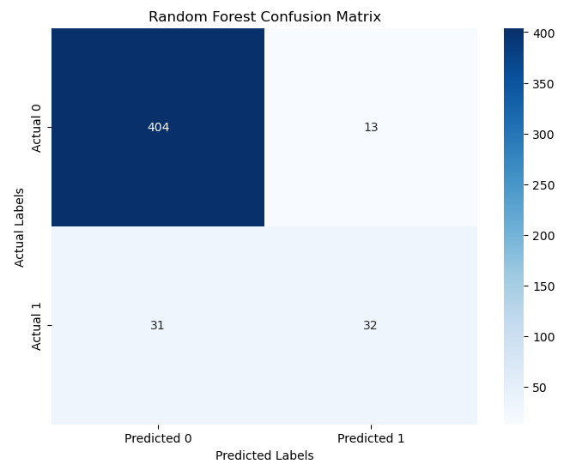
Conclusion:
Random Forest outperformed other models, making it the most reliable for this classification task, especially for predicting bad wines, which are the minority class in the dataset.
K-NN, SVM, and Gaussian Naive Bayes struggled with detecting bad wines, often failing to predict them effectively.
Logistic Regression provided a good baseline but showed poor performance for bad wines with low recall and precision.
Additional Findings:
Class imbalance: There were significantly more good wines than bad wines, which led to models being biased toward the majority class. Techniques like oversampling or undersampling could improve performance for Class 1.
Advanced models like ANN and XGBoost required significant fine-tuning to improve performance, and their computational cost was high.

Slide 9
Future Work & Discussion
Improvements:
Takeaways:
Class Imbalance Solutions: Implement techniques such as SMOTE (Synthetic Minority Over-sampling Technique) or use models that handle imbalanced data more effectively.
Hyperparameter Tuning: Fine-tune hyperparameters using grid search or random search to maximize model performance.
The Random Forest model provides the best overall performance for predicting red wine quality, especially for the minority class (bad wine). It strikes a balance between accuracy, precision, and recall, making it the ideal model for this classification task.

Slide 10

THANK YOU!

